Slide 1
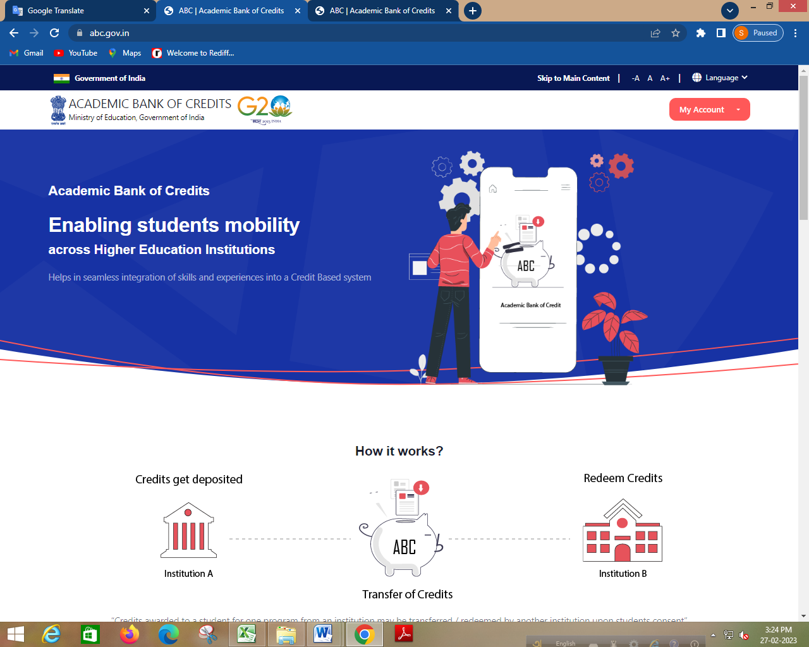
Registration under ABC platform
Web address www.abc.gov.in

Slide 2
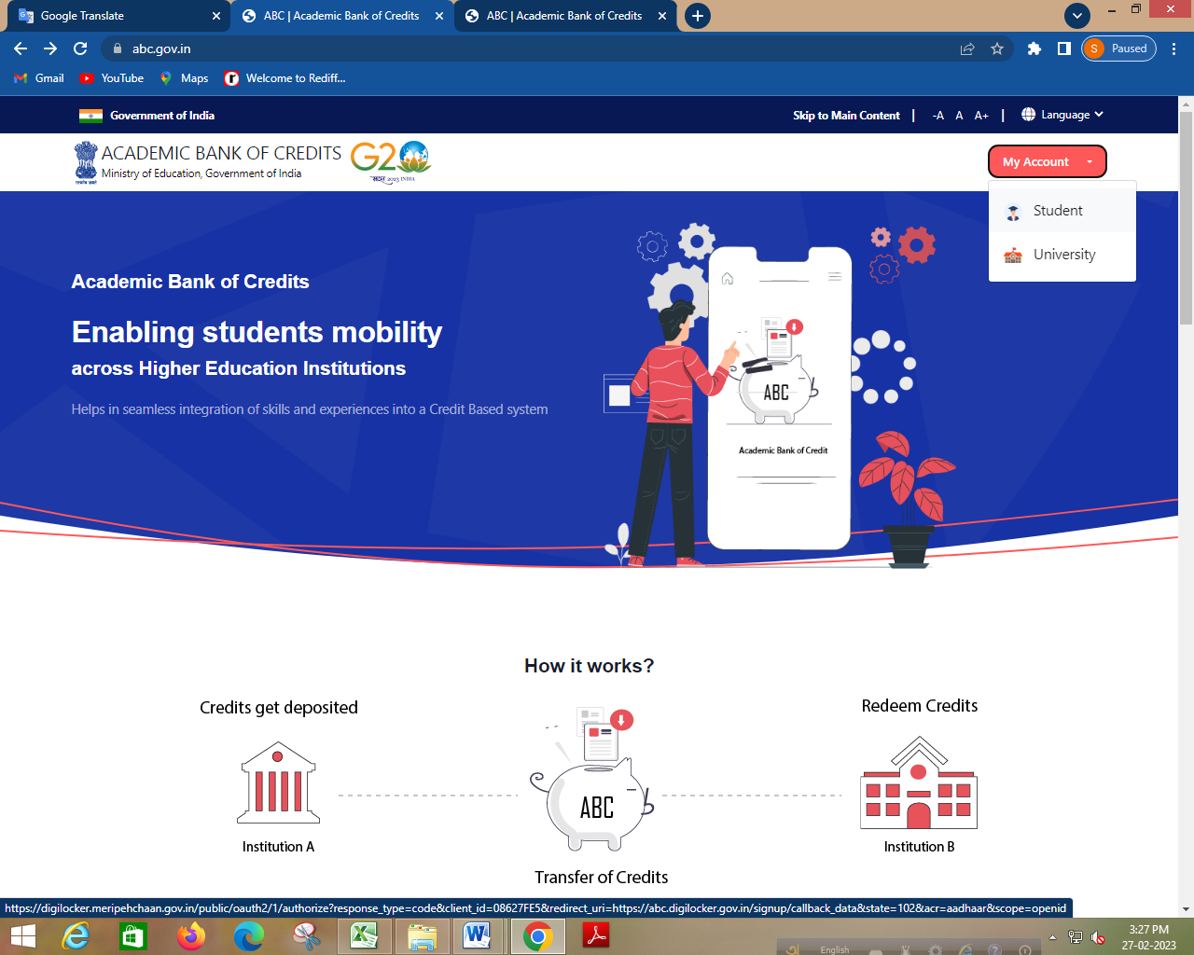

Slide 3
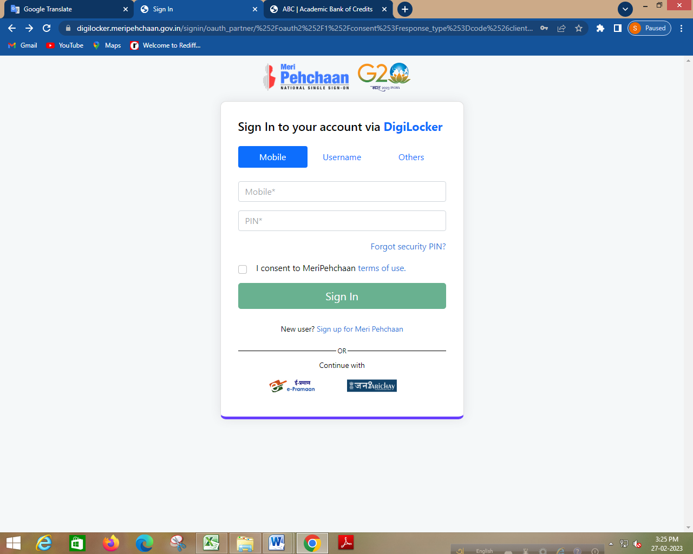

Slide 4
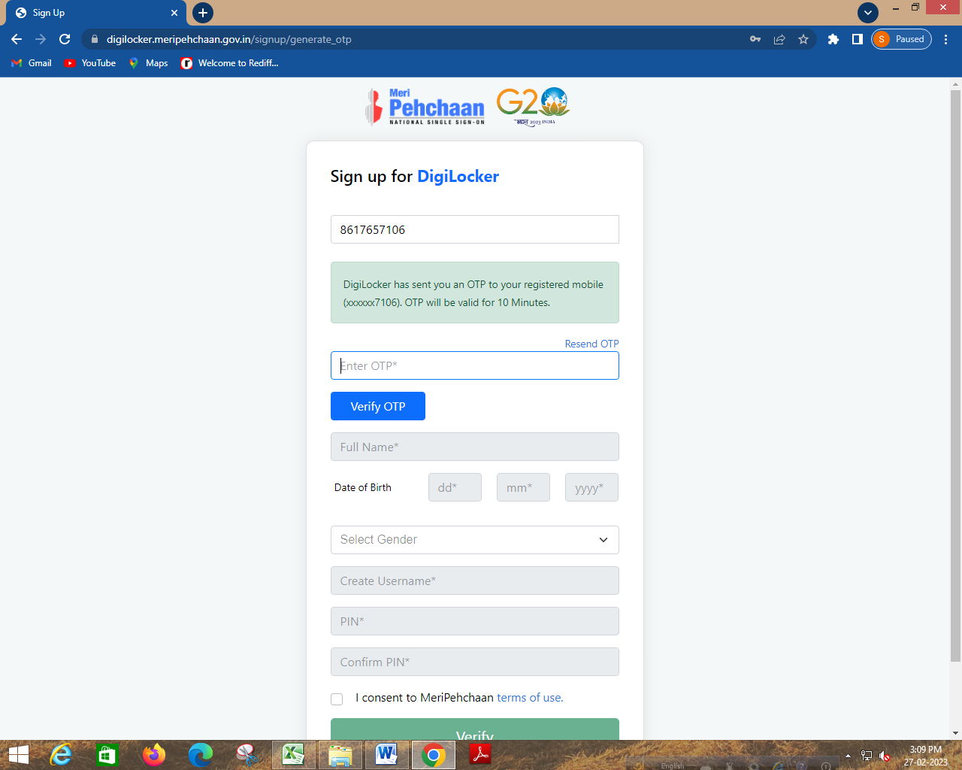
XXXXXXX

Slide 5
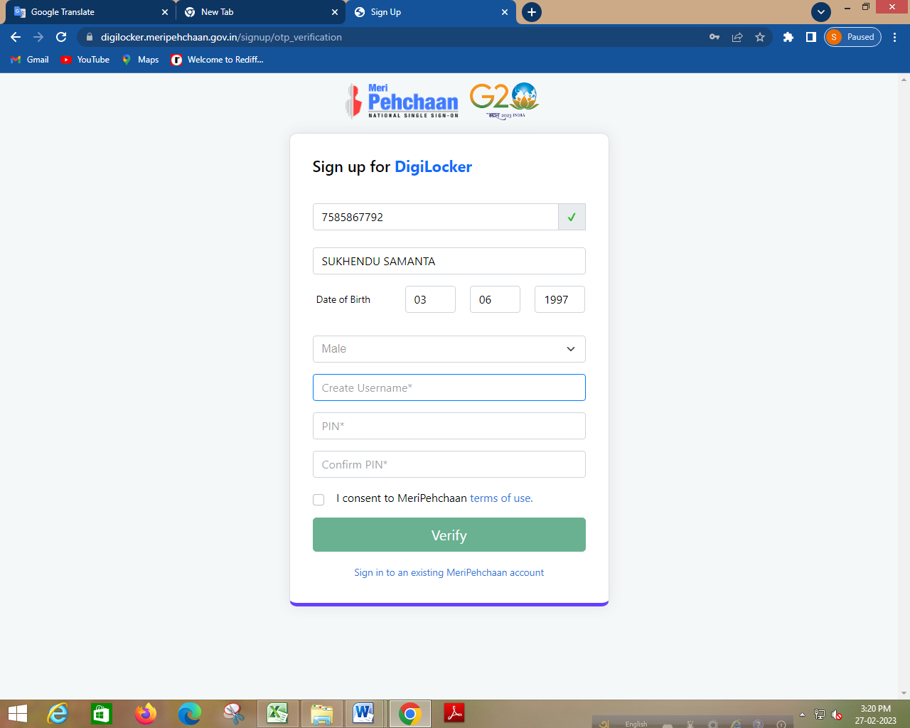
XXXXXXX
XXXXXXXXXXXXXXXX

Slide 6
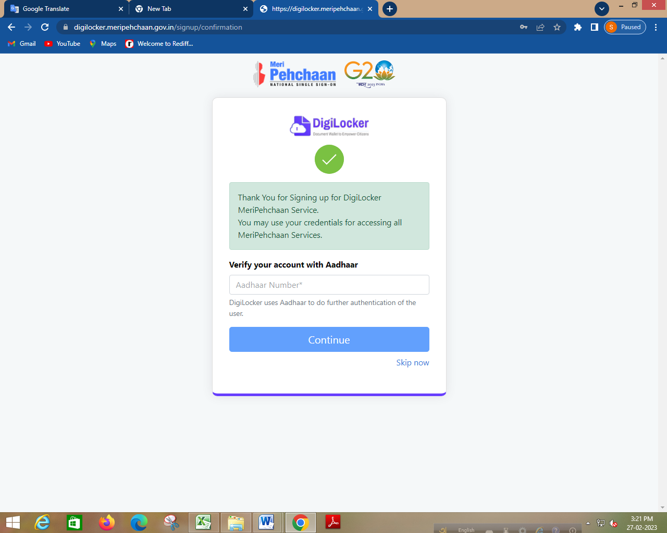

Slide 7
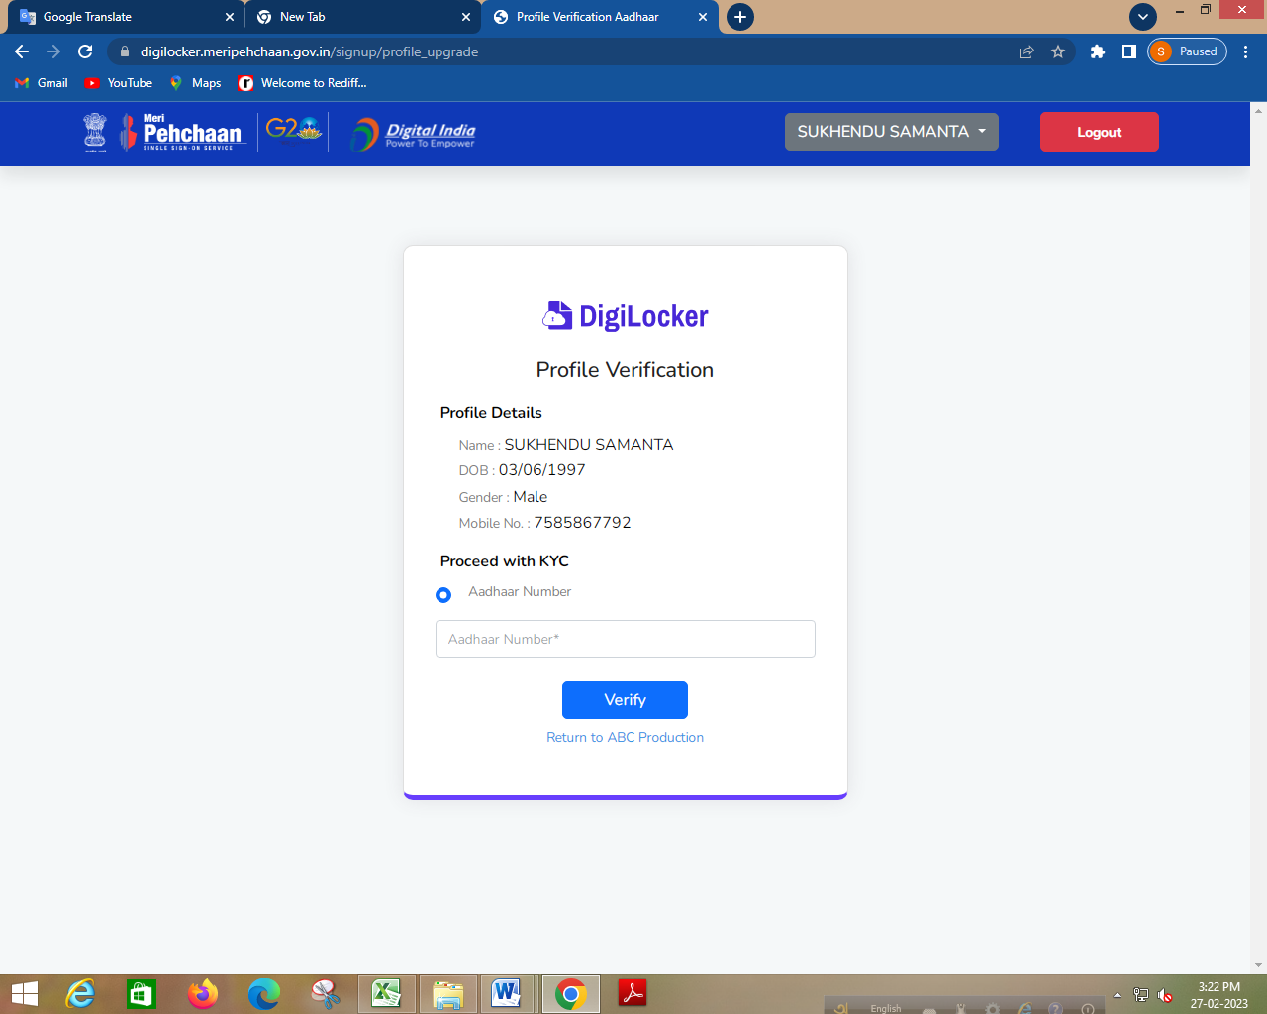
XXXXXXXXXXXXXXXXXX
XXXXXXXXXXXXXXXXXX
XXXXXXXXX

Slide 8
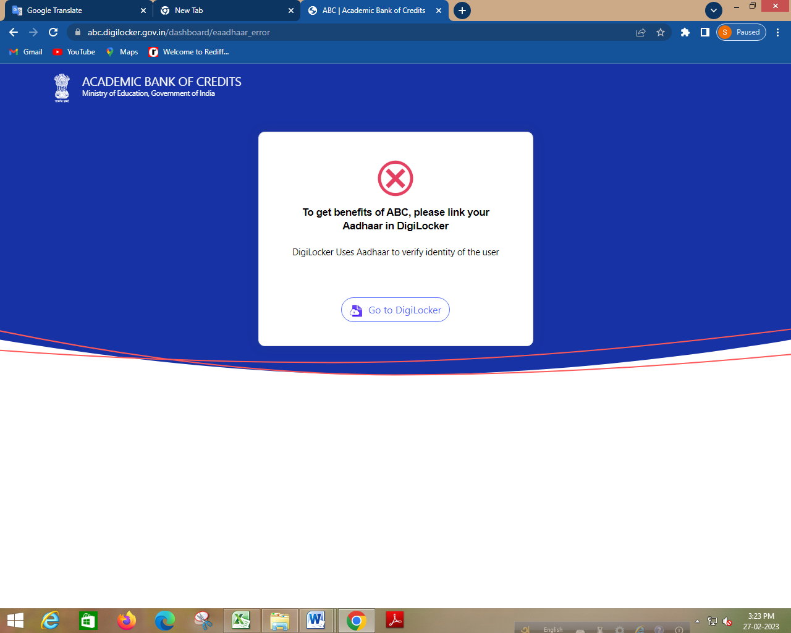

Slide 9
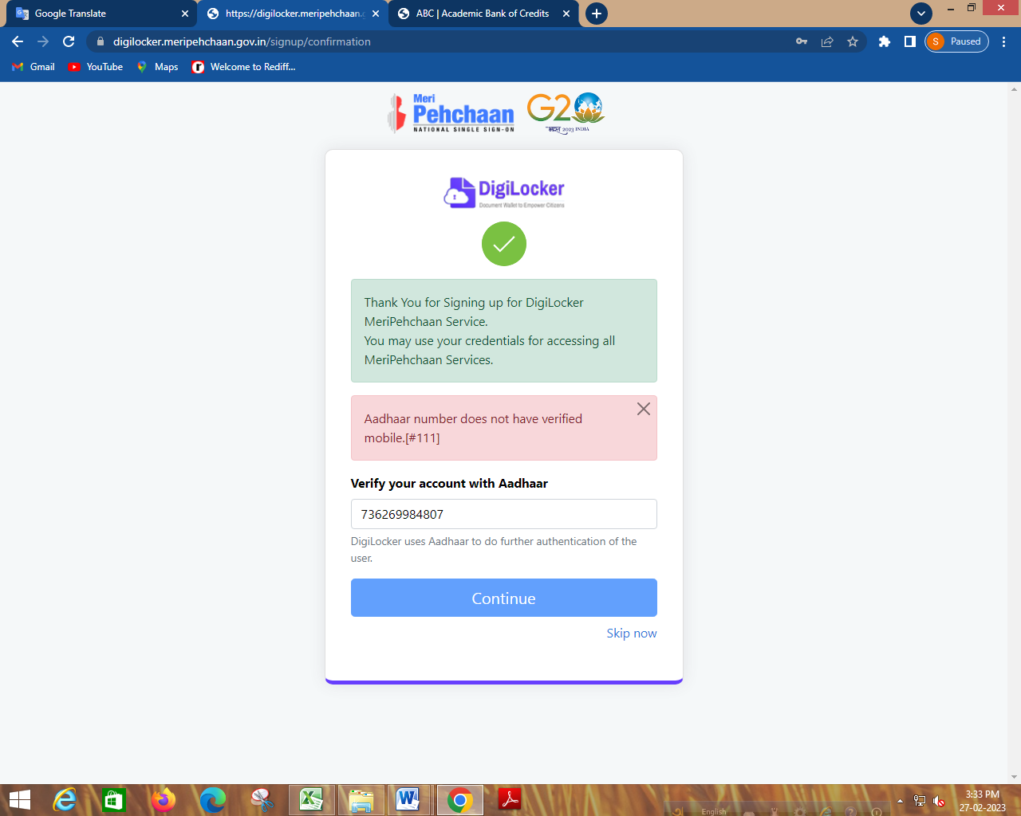
XXXXXXXxxxx

Slide 10
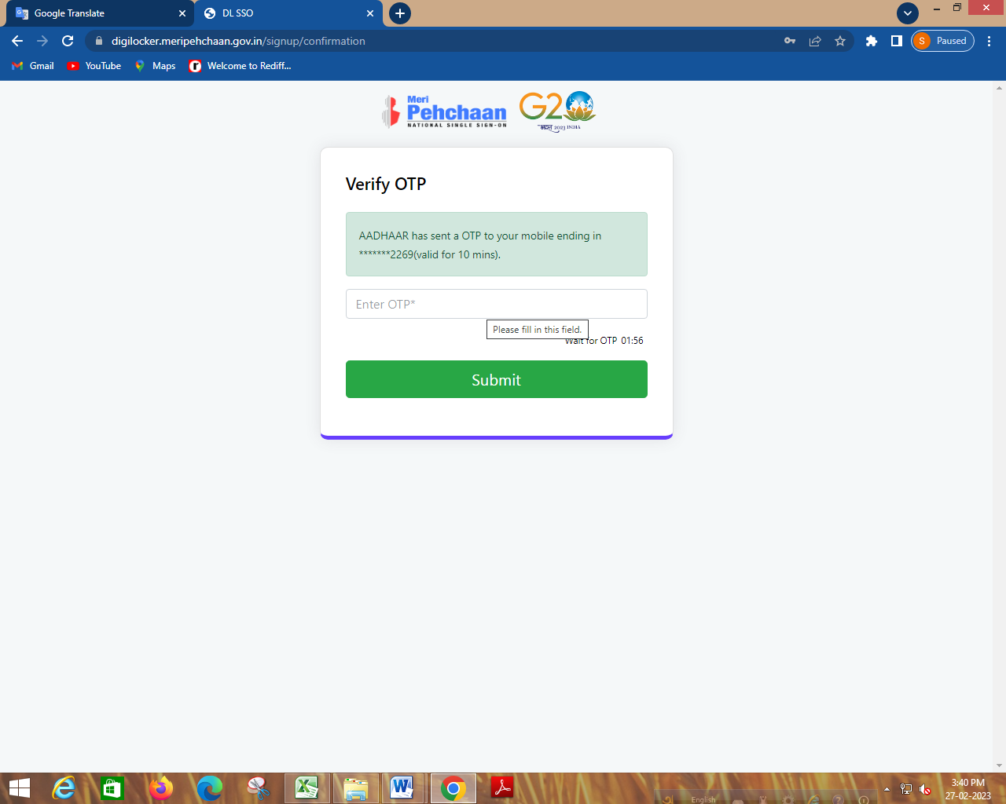

Slide 11
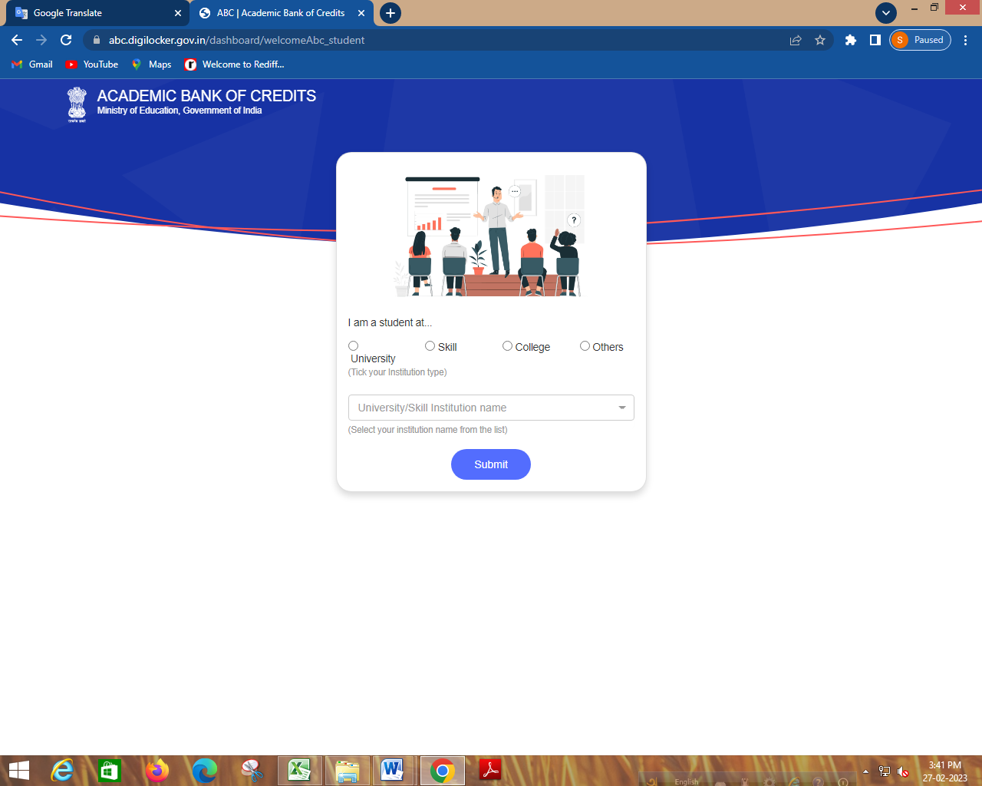

Slide 12
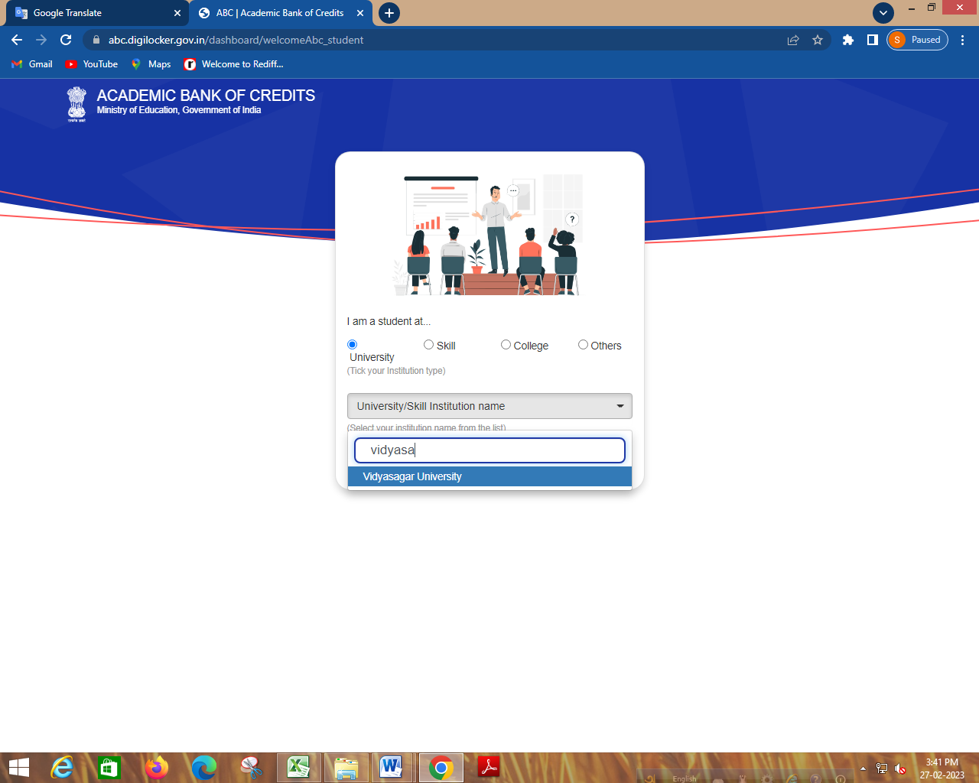

Slide 13
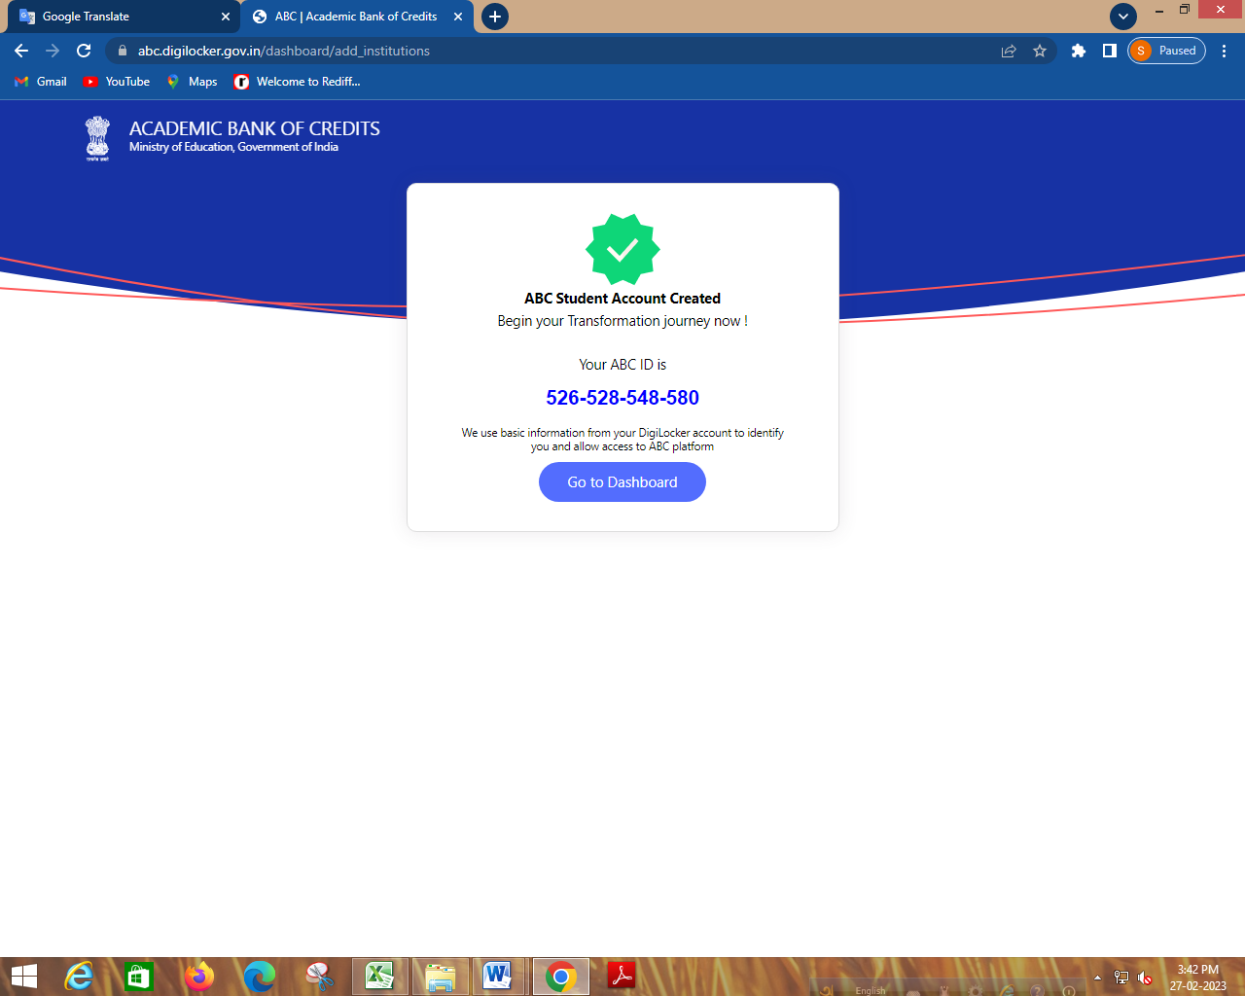

Slide 14
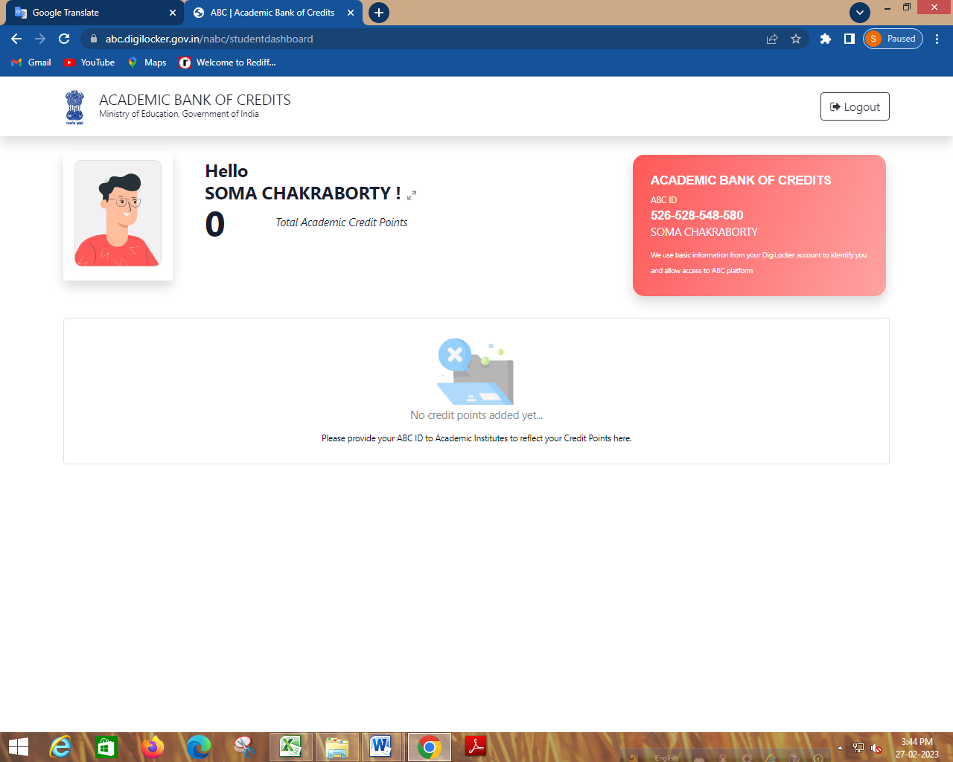
XXXXXXXXXXXXX
XXXXXXXXXXXXX

